Slide 1
Last Week’s Quiz

Slide 2
Last Week’s Assignment

Slide 3
Reminder to Complete Zybooks Sections
All assigned sections are to be completed each class before leaving
Any uncompleted sections are deducted from participation grade

Slide 4
Recap from Last Class
ADT
ArrayList
LinkedList

Slide 5
Lecture 4
Lists (cont.), Stacks, and Queues

Slide 6
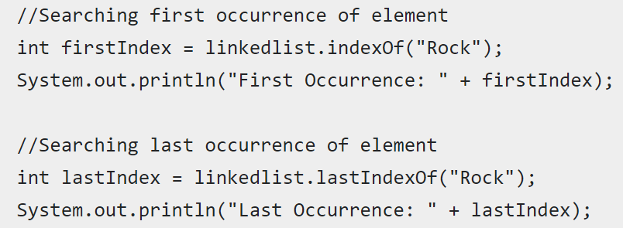
Linked List Search
How we search using the Java linked list ADT

Slide 7
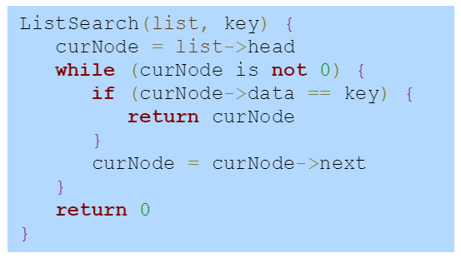
Linked List Search
What’s happening behind the scenes

Slide 8
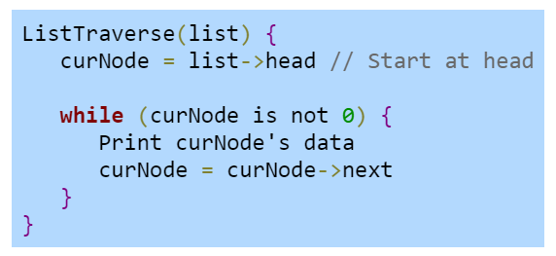
Linked List Traverse

Slide 9
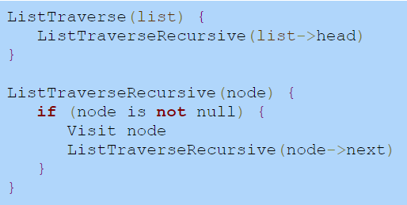
Linked List Traverse (using recursion)

Slide 10
Circular Linked List
Linked list where the tail node’s next pointer points to the head instead of null
A traversal through a circular linked list is similar to traversal through a standard linked list, but must terminate after reaching the head node a second time
Example use cases where you might want an infinitely looping list:
In a game, keeping track of which player’s turn it is
Providing CPU resources to a list of running processes

Slide 11
Vector
It is a computer science concept and a Java class (just like Linked List)
Functions similarly to ArrayList in Java
Automatically resizes when max capacity reached (defaults to double its size)
Can set custom capacity increment in constructor (different than ArrayList)
Synchronized (thread safe)
ArrayList is not synchronized

Slide 12
What does “Synchronized” mean?
Multi-threaded programs run multiple branches of code simultaneously
A situation can arise where multiple threads try to access the same resource
This can lead to unpredictable behavior or data corruption
Monitors are used to lock and unlock a resource to prevent this

Slide 13
Synchronization Example
A queue may be shared between threads
One thread receives messages from a data connection and pushes them to a queue
Another thread pops messages from the queue and processes them
This allows the message receive thread to run faster and keep up with rapid incoming messages because it’s not having to process the data
Using synchronization, we can make sure both threads aren’t concurrently modifying the queue which could result in unpredictable behavior or data corruption

Slide 14
List Traverse with ListIterator
A convenience for cycling through a list, works with both ArrayList and LinkedList
The lists we have covered can return a ListIterator object for themselves with their listIterator() method
The iterator starts at the beginning of the list and can move forwards and backwards
The iterator’s current location is not an index, it is between the previous and next element

Slide 15
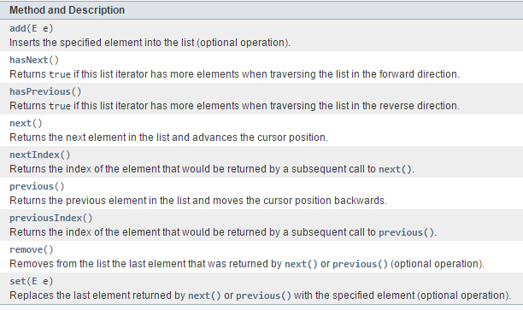
ListIterator in Java
ListIterator class to traverse linked list

Slide 16
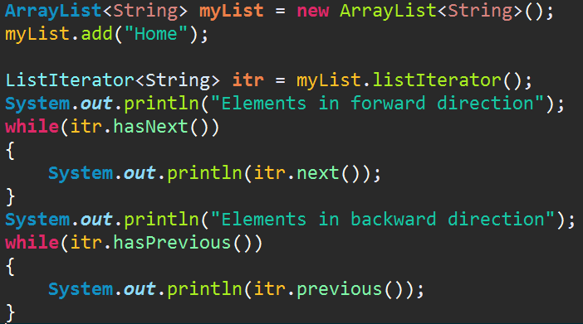
ListIterator

Slide 17
Stack ADT
An ADT where items are inserted or removed from the top of a stack of data
A “Last in First Out” data structure (LIFO)
Can be implemented using a linked list, an array, or a vector.
Java has a Stack class that is a subclass of the vector class

Slide 18
Stack ADT
The “push” operation inserts an item on the top of the stack
The “pop” operation removes AND returns the item at the top of the stack
The “peek” operation returns the top item in the stack but does NOT remove it

Slide 19
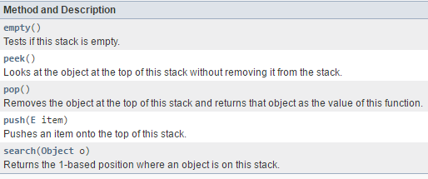
Stack Class in Java

Slide 20
Fun Non-Interactive Stack Example
Possible break before?

Slide 21
Queues
A queue is an ADT which items are inserted at the end of the queue and removed from the front of the queue.
The QueuePush() operation inserts an item at the end of the queue
The QueuePop() operation removes and returns the item at the front of the queue
Similar to a stack, but is first-in first-out (FIFO) instead of (LIFO)

Slide 22
Stack vs. Queue
A Stack is like a pile of dishes
Only the top dish can be removed directly
If you want one in the middle you have to remove all the dishes on top of it
A Queue is like a line of people waiting for the bathroom
The first person in line is the first to go
New people are added to the back of the line

Slide 23
Deque
A deque is an ADT in which items can be inserted and removed at both the front and back.
Dual Queue
The “push-front” operation inserts an item a the front
The “push-back” operation inserts at the back, etc.
Also supports “peek” operation

Slide 24
Applications of Deque
Storing web browser history
You need to add to the front but remove from both ends
Whenever you press back, you remove the item at front
After N number of sites, remove item at the back (only track the last N sites)
Storing an application’s list of undo operations
A line of people where:
A person is removed from the front of the line when they’re served
A person is removed from the back of the line when they are sick of waiting

Slide 25
Zybooks Sections Today
2.8, 2.11, 2.12, 2.17 –> 2.22

Slide 26
Quiz This Week
Topic: Stacks

Slide 27
Assignment 5
Topic: Stacks

